Slide 1
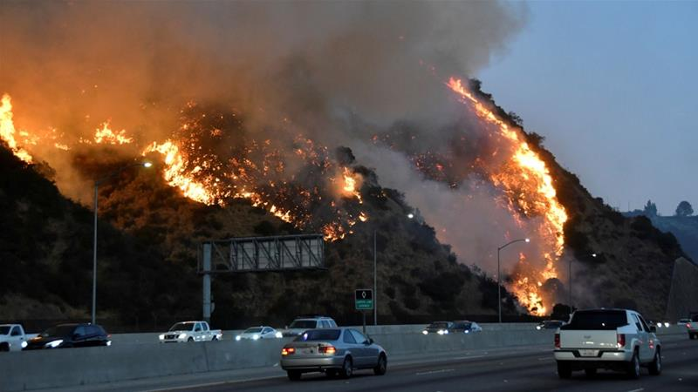
California Wildfires and How Precipitation Affects Them
Stephanie Zhao, Mike Shoemake, Kevin Eggert, Josh Jenkins

Slide 2
Agenda
Project overview
Data collection
Hypotheses
Implications

Slide 3
Project Overview
Central question: The Effect of Precipitation on Wildfires
Scope:
California
1932-2018
Top 20 Largest California Wildfires

Slide 4
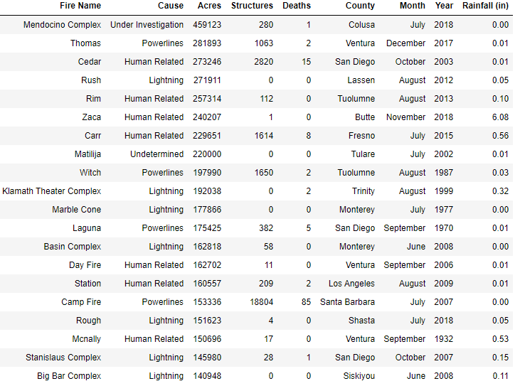
Data Collection
Merged Data
Datasets
Top 20 Largest California Wildfires (Kaggle.com)
Level of precipitation during each month each incident occurred
(https://www.ncdc.noaa.gov/cag/)
Parameters
Fire name
Cause
County
Month, Year
Precipitation (in)
Acres burned, Structures destroyed, Casualties
Limitations
Size of dataset
Difficulties in finding data

Slide 5
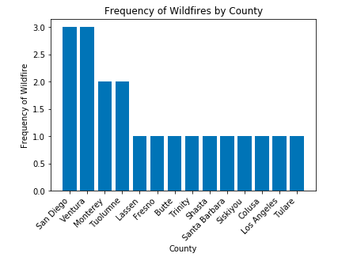
Is there a correlation between total amount of rainfall in a specific area and the total number of wildfires
Key Parameters:
Number of times a county appear on the Top 20 list
Total precipitation for the county of the given month that the fire occurs

Slide 6
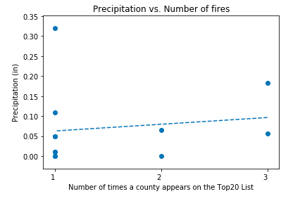
Results
Removed outliers: Butte, Fresno
R-value: 14.06%
Conclusion: There is weak to no correlation between the number of large wildfires that occurs in a county and the amount of precipitation it experiences during the same month.

Slide 7
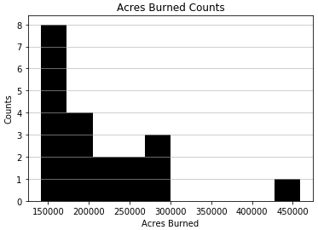
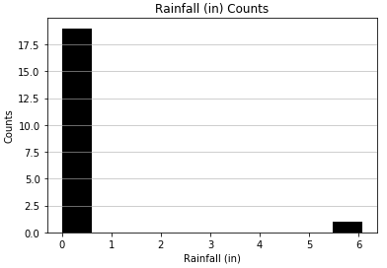
Is there a correlation between rainfall and the total number of acres burned?
Normal Check: cannot conclude we have a normal data set
Acres Burned - p value = 3.96
Rainfall (in) - p value = 1.10

Slide 8
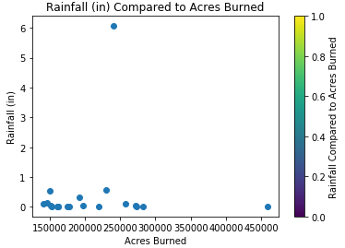
Is there a correlation between rainfall and the total number of acres burned?
Outlier Identified:
Zaca Wildfire in 2018: 6+ inches of rainfall

Slide 9
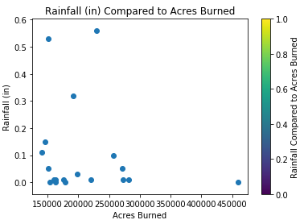
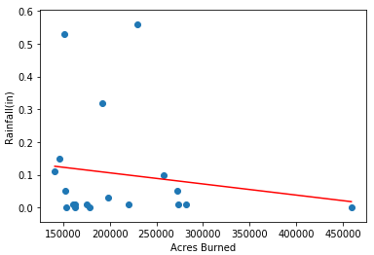
Is there a correlation between rainfall and the total number of acres burned?
After removal of the Zaca wildfire we see a better scatter but a trend cannot be identified
The correlation coefficient = -0.15 represents a negative trend which is in general what you may think: as inches of rainfall decrease more acres burn

Slide 10
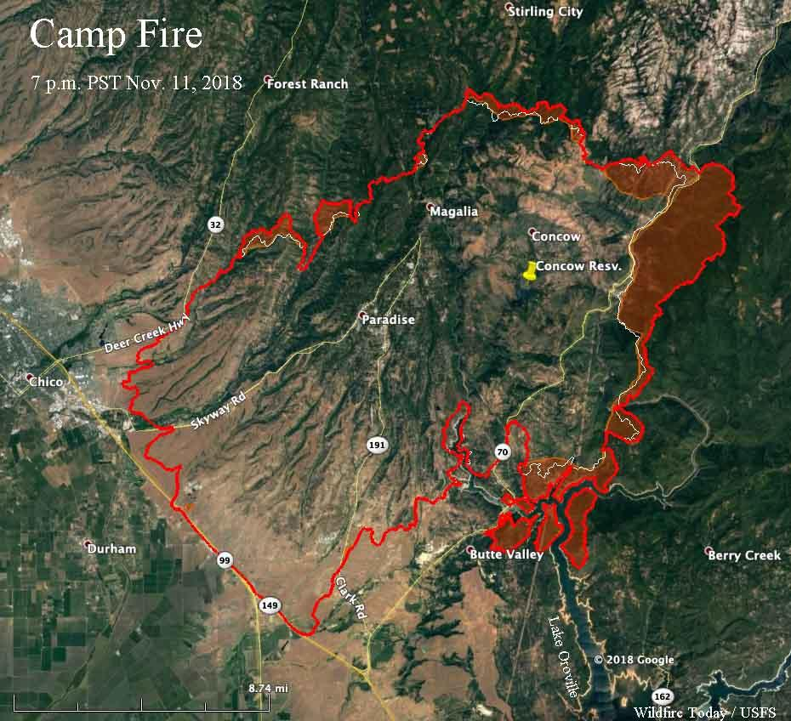
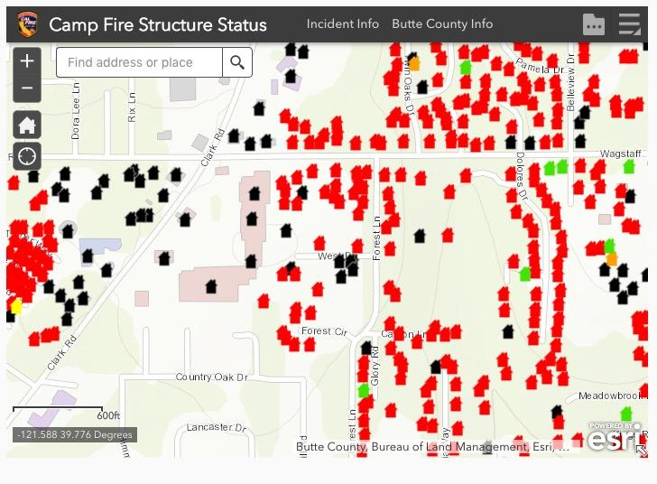
Is there a correlation between the number of structures affected and rainfall?
H1: If there is less rainfall during the month of a wildfire, then there will be a higher number of structures burned.
H0: The number of structures burned does not depend on rainfall.
Notes:
https://wildfiretoday.com/2018/11/12/fire-officials-release-list-of-structures-burned-in-camp-fire/
https://wildfiretoday.com/2018/11/13/cal-fire-releases-map-showing-status-of-structures-affected-by-camp-fire/

Slide 11
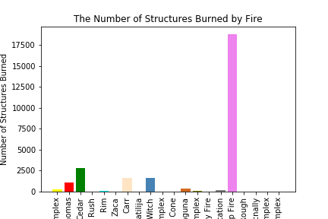
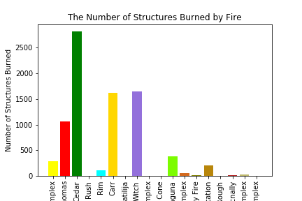
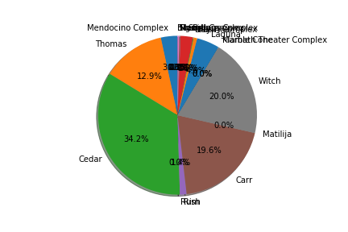
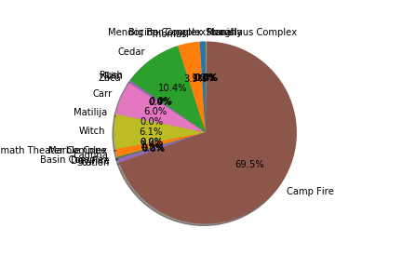
Is there a correlation between the number of structures affected and rainfall?

Slide 12
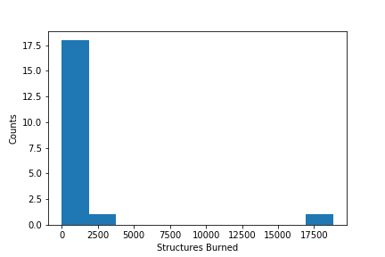
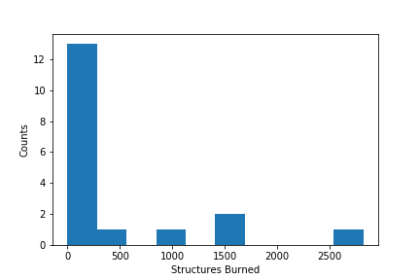
Is there a correlation between the number of structures affected and rainfall?
In our data, there were two noticeable outliers: Camp Fire and Zaca
After calculating for outliers for both structures burned and rainfall, 4 outliers were found for both structures burned and rainfall
Cedar, Carr, Witch, and Campfire were outliers for the number of structures burned as they are values above 1379.5 (2820, 1614, 1650, and 18804)
Zaca, Carr, Klamath, and Mcnally were outliers for rainfall as they are above .285 (6.08, 0.56, 0.32, 0.53)

Slide 13
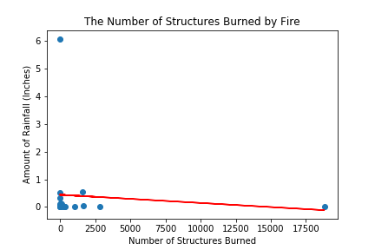
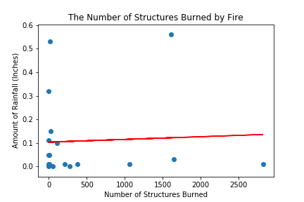
Is there a correlation between the number of structures affected and rainfall?
When graphing for correlation, the r-value is -.09 but after removing our outliers of Camp Fire and Zaca, our r-value is .05 - there is no correlation
With a p-value of 2.15, we cannot reject our null hypothesis

Slide 14
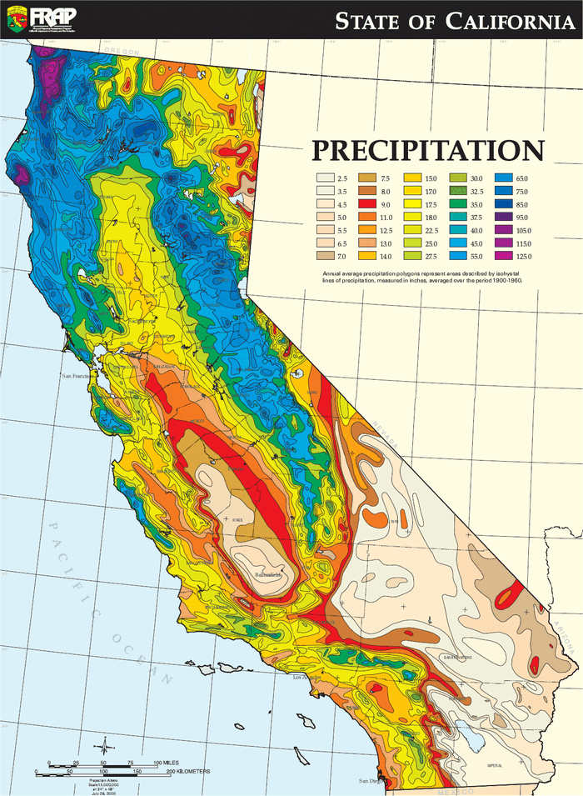
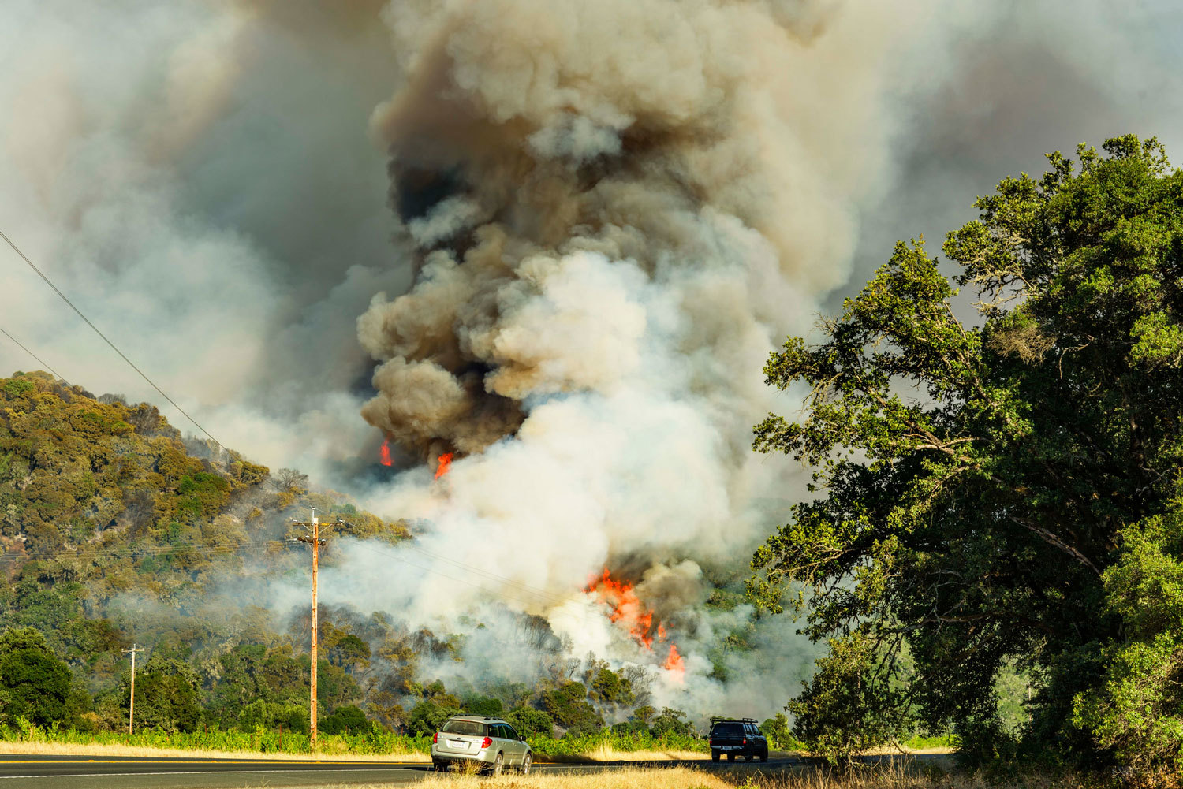
Is there a correlation between the number of deaths and rainfall?
H1: If there is less rainfall during the month of a large wildfire, then the number of deaths per fire will increase.
H0: There is no statistically significant relationship between rainfall and the number of deaths per fire.
Assumptions & Limitations

Slide 15
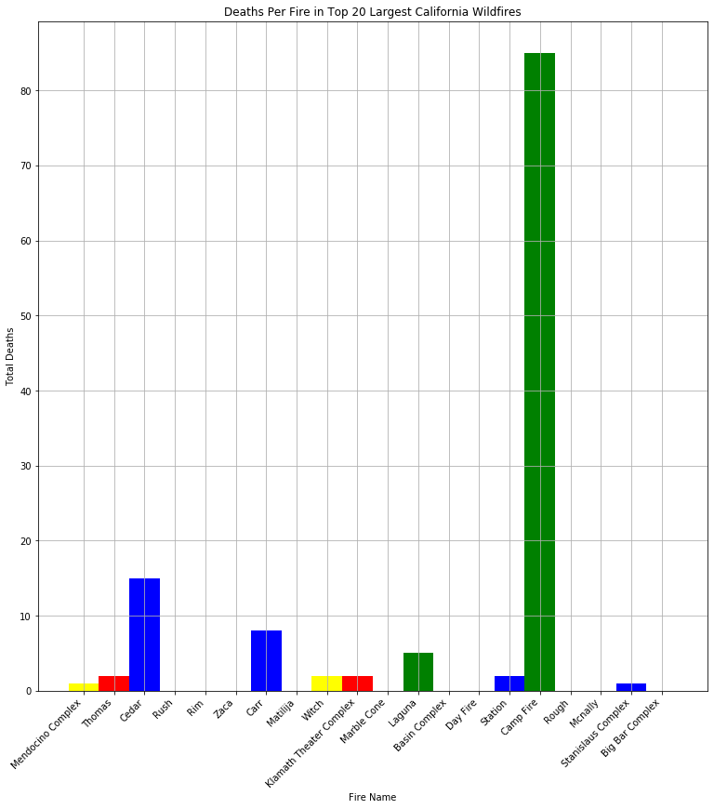
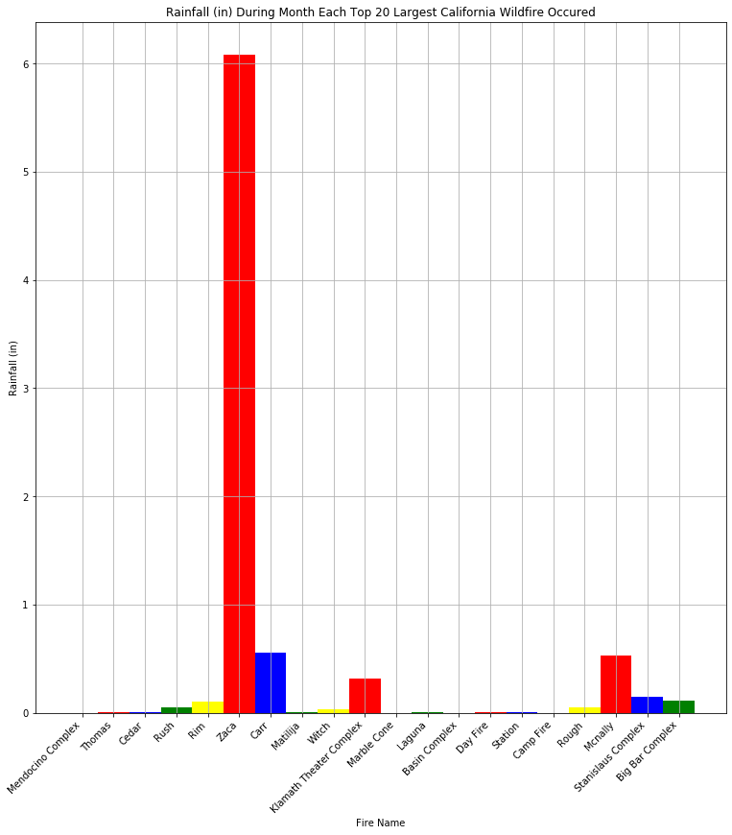
Is there a correlation between the number of deaths and rainfall?
Imported data set
Plotted bar plot to show deaths per fire and rainfall during month of fire:

Slide 16
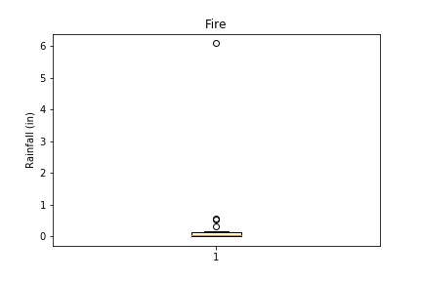
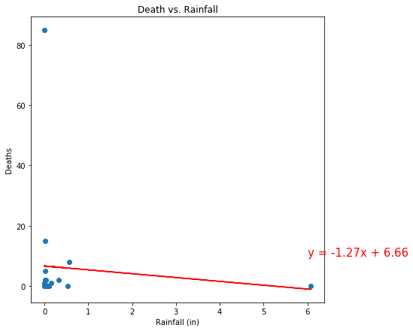
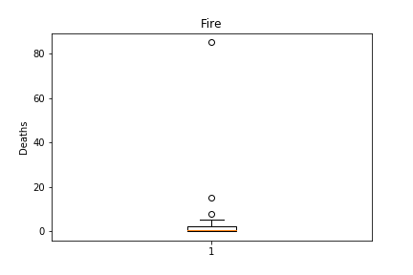
Is there a correlation between the number of deaths and rainfall?
Plotted scatter of linear regression for rainfall and deaths for each fire
Correlation of deaths and rainfall for the top 20 largest California wildfires:
Box and Whisker Plot to show Outliers
R squared: 0.00820944012545549
= No linear relationship

Slide 17
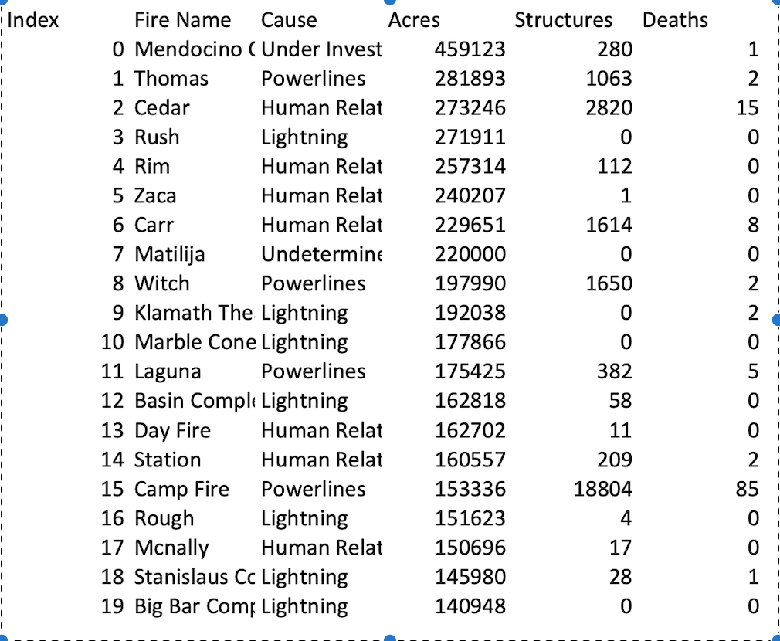
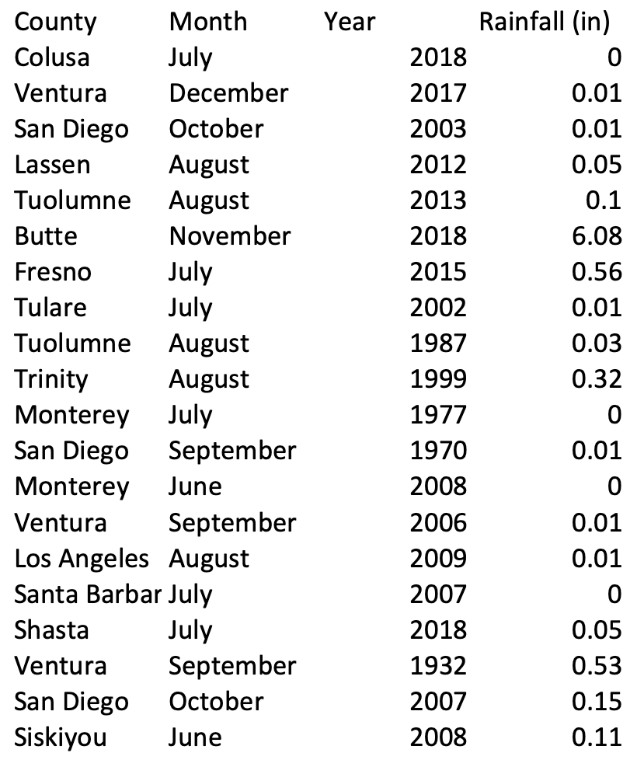
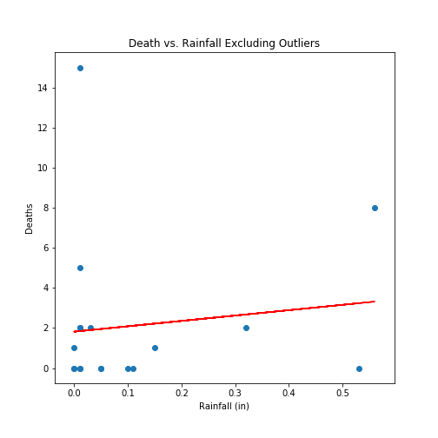
Is there a correlation between the number of deaths and rainfall?
Correlation of deaths and rainfall for the top 20 largest California wildfires excluding outliers:
Remove Outliers “Zaca” for rainfall and “Camp Fire” for number of deaths.
R squared: 0.015240264992158624
= Still no linear relationship

Slide 18
Is there a correlation between the number of deaths and rainfall?
For this question, we can conclude:
This data shows that there is no relationship or effect on the amount of total rainfall during the month of a large wildfire and how many deaths are caused by that fire.

Slide 19
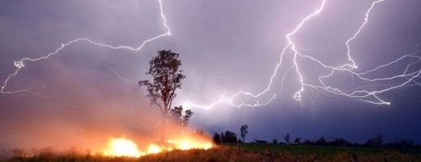
Conclusion
Things to keep in mind:
Data sample could be too small to be accurately representative of all California wildfires.
Weather data is tough to access.
Main Conclusion: Based on our data, we cannot determine that precipitation impacts wildfires or the effects wildfires have on the area they occurred in.
List of other factors that likely have more of an impact on wildfires than rain does:
Human Related
Lightning
Powerlines
Vegetation
Temperature
Ground Water
Other climate related factors

